Slide 1
Digital + Humanities
Linsey Dinh, Yvonne Gonzales, Jus Lim, Rohan Parekh

Slide 2
Introduction
The Digital Humanities work to close the divide in the academy between what is “digital” and what is “human”, creating a new discipline that bridges and combines the two fields and methods.
Notes:
Academia lives within departments. The English department may sometimes talk to the History department, but the History department may never speak to the people over in Statistics, or Computer Science. There’s this invisible barrier between what is “digital” and what is “humanities.” The digital and the human are not diametrically opposed, though, but rather quite interconnected. The digital could not exist without the humanities, and as the digital changes the world and how humans exist and interact, it becomes necessary to include the digital world within the study of the human world. The Digital Humanities should be an interdisciplinary field that works to close this almost fictional divide and use both humanist and digital methods to understand and research the world, in both scientific and humanist research.

Slide 3
Why Are the Digital Humanities So White?
Making a Case for the Black Digital Humanities
We Are All Social Scientists Now
McPherson, 2012
Gallon, 2016
Grimmer, 2015

Slide 4
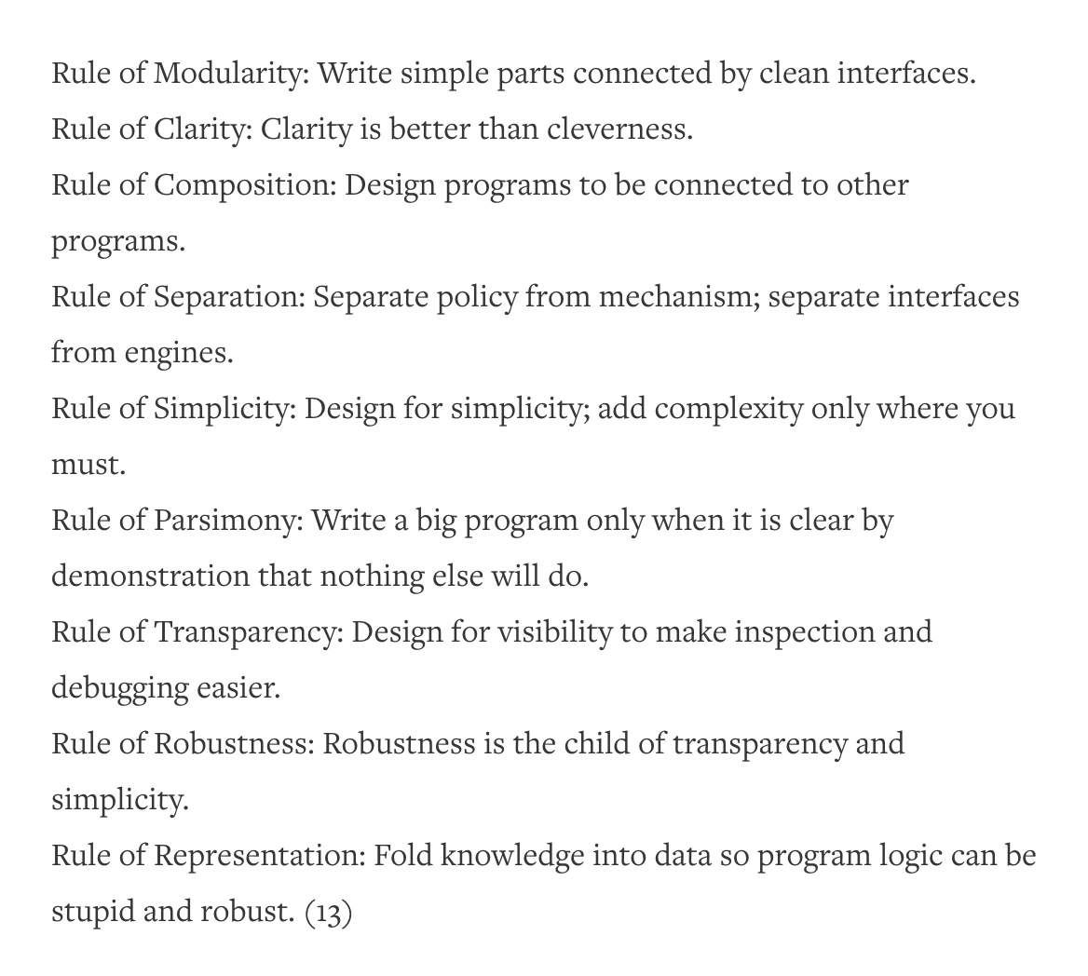
Why Are the Digital Humanities So White? or Thinking the Histories of Race and Computation
Tara McPherson, 2012
The historical background of both civil rights and computation
Rules of Computation connected to industrial America
Computation is inherently multicultural
Notes:
-Tara’s background in both humanities and digital humanities, noting the lack of overlap in topics between the two
-she presents a historical account of the origins of computing and how it connects to both the humanities and race
- the time period- 1960s, beginning of computing at MIT and Bell Labs but also the beginning of the young lords, black panthers, civil rights movements. These two things are not just parallel but intersecting, tied together
- The rules of computation, as written for the operating system UNIX, are tied into culture already: the security features connected to the cold war, the efficient modularity connected to industrialism and the Fordian assembly line
- clean interfaces also reflected in the social sphere of the 60’s, where brutality was often hidden behind curtains and “separate but equal” hid inherent racism; the hiding of code behind graphic interfaces reflects that model and the parcelling of systems into completely separate, and modular entities reflects the parceling of information in modern scholarship as well
“computers themselves are encoders of culture” and that their uses in relationship to race, class, and gender, are just as important as their technical capabilities.
In Tara McPherson’s “Why Are the Digital Humanities So White? or Thinking the Histories of Race and Computation” she goes into the interconnected histories of both computing and social justice. Her moment of comparison is the 1960s, a period where operating systems and networks were being created for the first time, right alongside the Civil Rights Movement, the Black Panthers, and the Young Lords. She then looks at the fundamental rules of good operating systems, and connects them to the changing social and political climate. Even the origins of computing are caught up in the humanist questions of identity politics and encapsulation. She shows that “computers themselves are encoders of culture” and that their uses in relationship to race, class, and gender, are just as important as their technical capabilities.

Slide 5
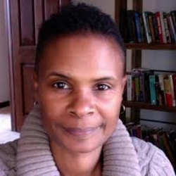
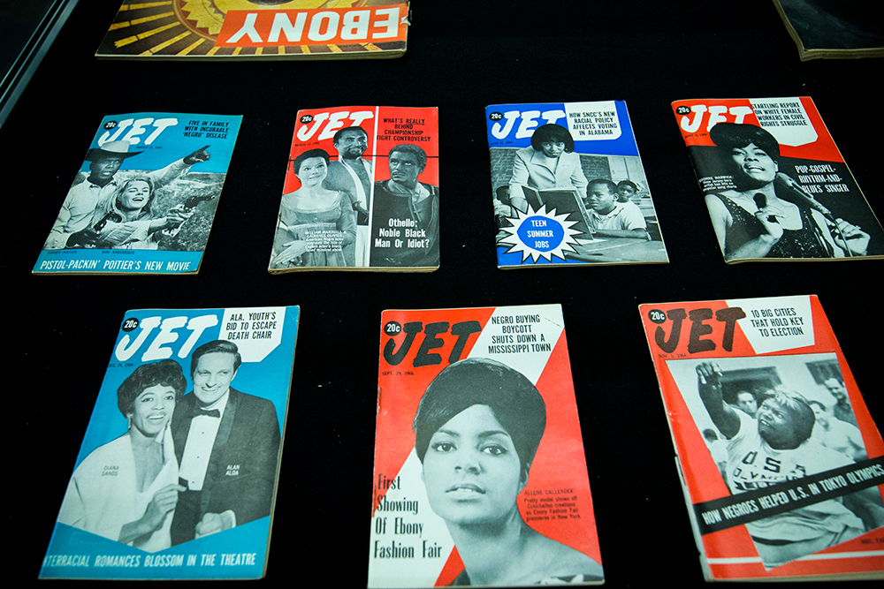
Making a Case for the Black Digital Humanities - Gallon, 2016
[Source]
Overview
Kim Gallon - Background and Motivation
What is “Technology of recovery”?
History behind Black Digital Humanities
Impact of the Black Digital Humanities and Technology of recovery
[source]
Notes:
Firstly, I would like to introduce our author Kim Gallon. Kim Gallon is an associate professor of history at Purdue university. In her work she investigates the cultural dimensions of 20th Century Black Press and the black digital humanities as a site of resistance and liberation.
That said, and transitioning into the topic of this article, Kim Gallon focuses on highlighting the concept of “technology of recovery”, not through utilizing it herself, but creating discussion around the subject and the history behind it
Technology of recovery is a restorative process of the stolen humanity of Black people by racism, through recovering lost historical and literary text. It gives a basis to black digital scholarship and bridges the gap between black studies and digital humanities.
As this gap is bridged, Black digital humanities is formed from the intersection of disciplines.
To fully understand the technology of recovery we must discuss the history of the Black digital humanities. Black studies was born from the Civil Rights and Black Nationalist movements of the 1960s, and is a study of Black culture and the social experiences of Black people under the power of eurocentric systems. The foundation of the Black digital humanities is technology of recovery, which aims at incorporating black voices, African American,and African Diasporic experiences to transform literary canons and history.
Black digital humanities have allowed us to unmask the racialized systems at work, as the utilization of recovery allows us to consider political relations that have transformed literary, historical, and even philosophical text. Revealing how the humanities has developed through a system of power. With technology evolving everyday, black movements have a place on social media, making the collective humanity and the disparities of black people apparent to the public world.
Gallon considers Black Digital Humanities as a means of systemic change by dissecting the way we think about humanity: acting as a mechanism for deregulating the tendency of technological tools,to deemphasize questions about humanity itself.
Not only is the Black Digital Humanities an example of the interconnected worlds of the digital and the humanities, but it is a platform where the digital can RECOVER humanity.

Slide 6

We Are All Social Scientists Now - Grimmer, 2015
Necessity of closer relationship between social and computer science
Social sciences are needed to better analyze big data
Big data and machine learning assist with causal inferences
[Source]
“Social scientists know that large amounts of data will not overcome the selection problems that make causal inference so difficult.”
Notes:
Justin Grimmer
Political Science professor at Stanford
Particular focus on data science
Several papers that investigate how to effectively apply machine learning to political data and social science in general
Article
In this particular paper, Grimmer discusses the newfound role social science has in computer science
Modern technology allows for the mass production and aggregation of information into huge corpuses of text
The social sciences are necessary to effectively analyze such large quantities of data in a way that yields useful information.
“Social scientists know that large amounts of data will not overcome the selection problems that make causal inference so difficult.”
It isn’t enough to have large amounts of data to apply machine learning to, social science skills need to be applied as well in order to effectively analyze the data and draw the correct conclusions from it
This intertwining of disciplines also applies in the other direction; the new advances in computer science many applications that can benefit the social sciences
Grimmer specifically refers to how machine learning and big data can be combined with causal inference to assist social scientists
Modern methods of data creation and collection alone give social scientists unbelievably large amounts of data they can use to make observations
Social scientists can take this further by using machine learning models to analyze these large amounts of data to make more observations and better informed observations

Slide 7
Takeaways:
Main Findings:
Grimmer: Big Data and Social Science experts could benefit from engaging with each others’ fields!
McPherson: Multicultural data science requires multicultural systems!
Gallon: Black Digital Humanities requires including Black perspectives on humanity in a digital context!
Broader Implications:
Grimmer: Solving problems, especially with Big Data, is requiring a growing amount of interdisciplinarity.
McPherson & Gallon: Advocate for a widening perspective of Digital Humanities and provide urgency for critical thought-process reexamination and the consistent inclusion of marginalized voices.
Notes:
Main Findings:
In short, each author’s argument either points to where Digital Humanities can improve or what areas must continue to be focused for improvement.
The Grimmer article explains that Big Data’s capacity to upscale Social Science research allows social scientists to create more accurate conclusions; conversely, social science’s robust research design can ensure the quality of working with data-- which gets difficult when working with a lot.
In giving a detailed overview of the parallel histories of the computing industry and radical political climate in America during the 1960s and 70s, McPherson’s main argument is to critically re-evaluate our systems of information created in response to the struggle for racial justice.
Thirdly, Gallon frames an intersection between the Digital Humanities and Black studies highlighting how Black perspectives have historically been excluded from definitions of humanity. Thus, an intersection between the digital and humanities requires a critical examination of how technology might perpetuate racially discriminatory ideologies.
These conclusions are heavily relevant to the state of the field today.
For one, Grimmer’s article proves how our advancing technology is creating obstacles with more complexity, calling scientists to bridge different fields.
Moreover, McPherson and Gallon both point to the urgency in addressing the racially discriminatory history of digital and humanities work to not carry them over. In this way, reexamining the digital and humanities’ relationship with race and racial justice would help bridge the gap between the growing field of Digital Humanities.

Slide 8
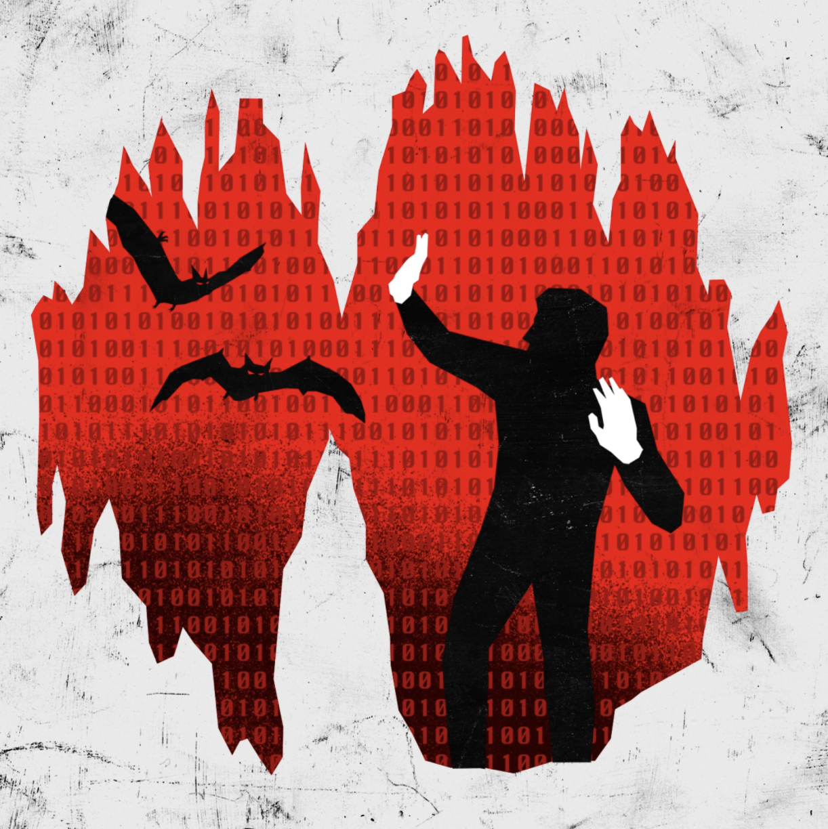
“The Digital Humanities Debacle”
Summary: Digital Humanities Debacle
Pros
New ways to examine literature
Can look at large amounts of content at a time
Cons
Most findings are exploratory
Field is running on ‘potential’
McPherson and Gallon
Race is another cultural gap crucial to making relevant claims in humanities
[Source]
Notes:
The last two articles, McPherson’s and Gallon’s, are also very relevant to Dr. Nan Z. Da’s proposed “Digital Humanities Debacle”.
For context, Dr. Da’s Debacle can best be described as a lack of real literary significance in most digital humanities findings. In this way, Da is pointing to the chasm which currently lies between the digital and the humanities. Due to the fact that the bridge scholars are crafting is still in its infancy, much of the findings of Digital Humanities work, Da argues, has not been as impressive as the potential that using digital methods on humanities data initially had.
With regards to the readings, the McPherson and Gallon article both point to race as an historical blindspot of the digital and humanities. Similar to Da’s point, bridging the gap between the Digital and the Humanities includes reexamines their relationship with racial justice to provide critical literary conclusions.

Slide 9
Thank you for listening!

